Slide 1
Distributed Arithmetic ECE 4740/5740 Professor Hanna

Slide 2

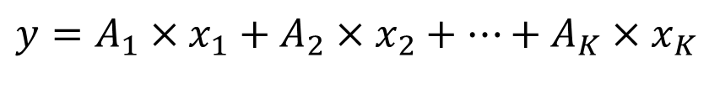
MAC Operations
Multiply and accumulate operation
$$y=A_{1}×x_{1}+A_{2}×x_{2}+⋯+A_{K}×x_{K}$$
$$y=\sum_{k=1}^{K}{A_{k}x_{k}}$$

Slide 3

MAC Operations
$$y=\sum_{k=1}^{K}{A_{k}x_{k}}$$
A=[A₁, A₂, …, A_{k}] is a matrix of previously determined values (i.e. filter coefficients)
x=[x₁, x₂, …, x_{k}] is a matrix of inputs
Each A_{k} has M-bits and x_{k} has N-bits

Slide 4
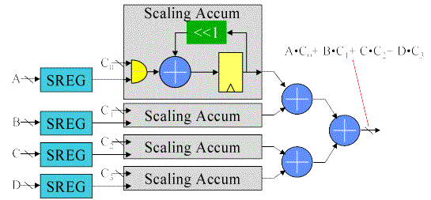
MAC Operations
$$A=\left[C_{1},C_{2},C_{3},C_{4}\right] x=\left[A,B,C,D\right] (K=4)$$
Shift right
Registers to hold sum of partial products
Multi-bit AND gate
Each scaling accumulator calculates A_{i} X x_{i}
Adder/Subtractor
Shift registers

Slide 5
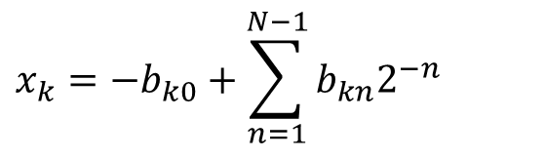

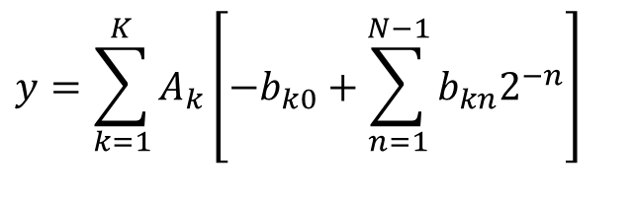
Distributed Arithmetic
x_{k} is an N-bit normalized two’s complement number
| x_{k} | < 1
x_{k} : {b_{k0}, b_{k1}, b_{k2}……, b_{k(N-1)} }
where b_{k0} is the sign bit
We can express x_{k} as
Substituting (2) in (1),
$$y=\sum_{k=1}^{K}{A_{k}x_{k}}$$
(1)
$$x_{k}=−b_{k0}+\sum_{n=1}^{N−1}{b_{kn}2^{−n}}$$
(2)
$$y=\sum_{k=1}^{K}{A_{k}\left[−b_{k0}+\sum_{n=1}^{N−1}{b_{kn}2^{−n}}\right]}$$

Slide 6
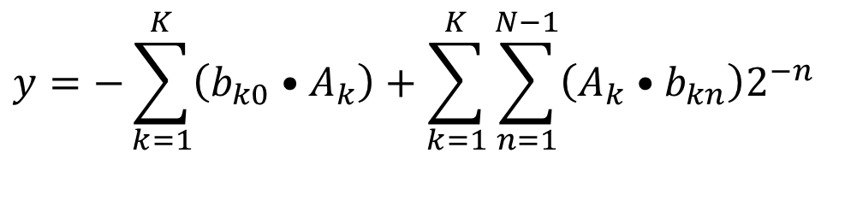
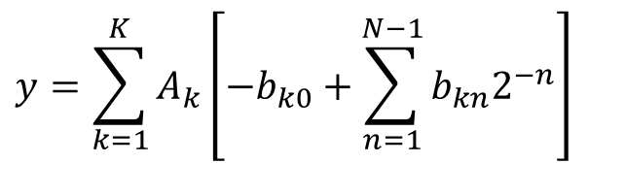
Distributed Arithmetic
$$y=\sum_{k=1}^{K}{A_{k}\left[−b_{k0}+\sum_{n=1}^{N−1}{b_{kn}2^{−n}}\right]}$$
$$y=−\sum_{k=1}^{K}{\left(b_{k0}•A_{k}\right)}+\sum_{k=1}^{K}{\sum_{n=1}^{N−1}{\left(A_{k}•b_{kn}\right)2^{−n}}}$$
(3)

Slide 7

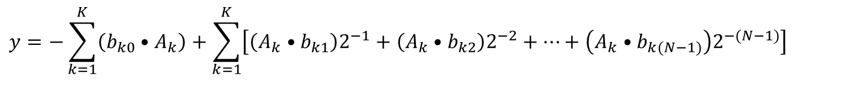
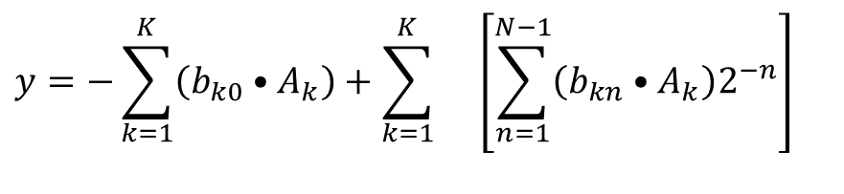
Distributed Arithmetic
$$y=−\sum_{k=1}^{K}{\left(b_{k0}•A_{k}\right)}+\sum_{k=1}^{K}{ \left[\sum_{n=1}^{N−1}{\left(b_{kn}•A_{k}\right)2^{−n}}\right]}$$
(3)
$$y=−\sum_{k=1}^{K}{\left(b_{k0}•A_{k}\right)}+\sum_{k=1}^{K}{\left[\left(A_{k}•b_{k1}\right)2^{−1}+\left(A_{k}•b_{k2}\right)2^{−2}+⋯+\left(A_{k}•b_{k(N−1)}\right)2^{−(N−1)}\right]}$$
$$y=−\left[b_{10}•A_{1}+b_{20}•A_{2}+⋯+b_{K0}•A_{K}\right] \\ +\left[\left(b_{11}•A_{1}\right)2^{−1}+\left(b_{12}•A_{1}\right)2^{−2}+⋯+\left(b_{1\left(N−1\right)}•A_{1}\right)2^{−\left(N−1\right)}\right] \\ +\left[\left(b_{21}•A_{2}\right)2^{−1}+\left(b_{22}•A_{2}\right)2^{−2}+⋯+\left(b_{2\left(N−1\right)}•A_{2}\right)2^{−\left(N−1\right)}\right] \\ ⋮ \\ +\left[\left(b_{K1}•A_{K}\right)2^{−1}+\left(b_{K2}•A_{K}\right)2^{−2}+⋯+\left(b_{K\left(N−1\right)}•A_{K}\right)2^{−\left(N−1\right)}\right]$$

Slide 8
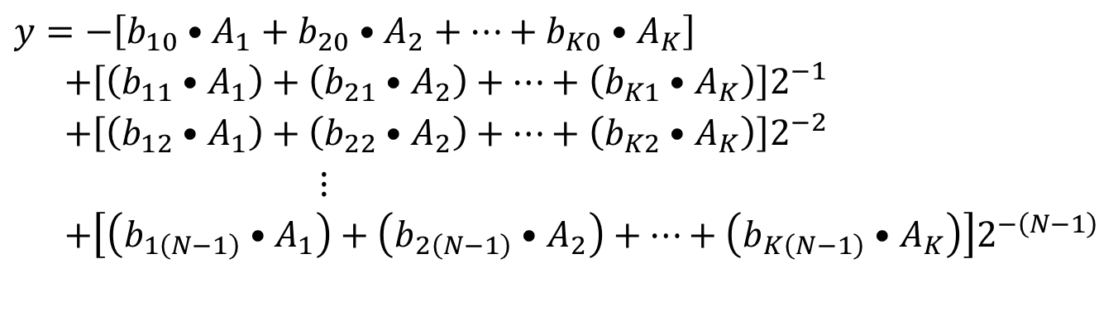

Distributed Arithmetic
$$y=−\left[b_{10}•A_{1} +b_{20}•A_{2} +⋯+ b_{K0}•A_{K}\right] \\ +\left[\left(b_{11}•A_{1}\right)2^{−1}+\left(b_{12}•A_{1}\right)2^{−2}+⋯+ \left(b_{1\left(N−1\right)}•A_{1}\right)2^{−\left(N−1\right)}\right] \\ +\left[\left(b_{21}•A_{2}\right)2^{−1}+\left(b_{22}•A_{2}\right)2^{−2}+⋯+ \left(b_{2\left(N−1\right)}•A_{2}\right)2^{−\left(N−1\right)}\right] \\ ⋮ \\ +\left[\left(b_{K1}•A_{K}\right)2^{−1}+\left(b_{K2}•A_{K}\right)2^{−2}+⋯+\left(b_{K\left(N−1\right)}•A_{K}\right)2^{−\left(N−1\right)}\right]$$
$$y=−\left[b_{10}•A_{1}+b_{20}•A_{2}+⋯+b_{K0}•A_{K}\right] \\ +\left[\left(b_{11}•A_{1}\right)+\left(b_{21}•A_{2}\right)+⋯+\left(b_{K1}•A_{K}\right)\right]2^{−1} \\ +\left[\left(b_{12}•A_{1}\right)+\left(b_{22}•A_{2}\right)+⋯+\left(b_{K2}•A_{K}\right)\right]2^{−2} \\ ⋮ \\ +\left[\left(b_{1\left(N−1\right)}•A_{1}\right)+\left(b_{2\left(N−1\right)}•A_{2}\right)+⋯+\left(b_{K\left(N−1\right)}•A_{K}\right)\right]2^{−\left(N−1\right)}$$

Slide 9
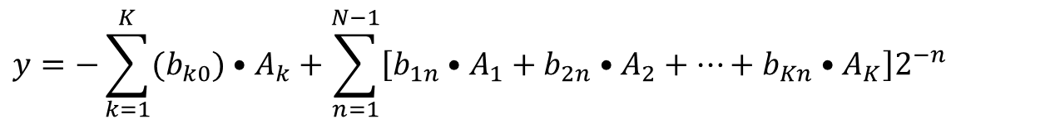
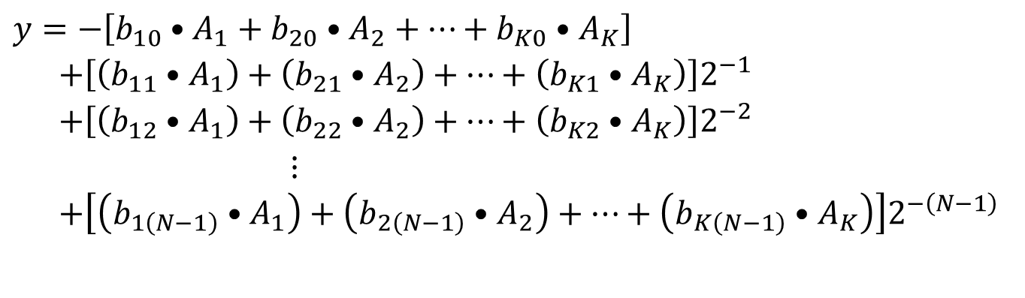
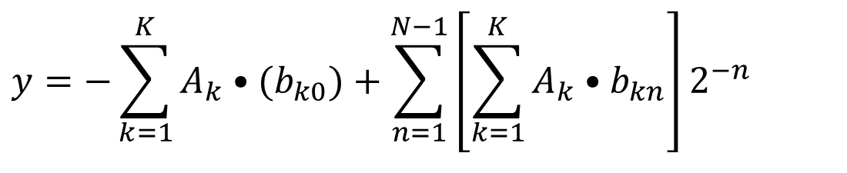
Distributed Arithmetic
$$y=−\left[b_{10}•A_{1}+b_{20}•A_{2}+⋯+b_{K0}•A_{K}\right] \\ +\left[\left(b_{11}•A_{1}\right)+\left(b_{21}•A_{2}\right)+⋯+\left(b_{K1}•A_{K}\right)\right]2^{−1} \\ +\left[\left(b_{12}•A_{1}\right)+\left(b_{22}•A_{2}\right)+⋯+\left(b_{K2}•A_{K}\right)\right]2^{−2} \\ ⋮ \\ +\left[\left(b_{1\left(N−1\right)}•A_{1}\right)+\left(b_{2\left(N−1\right)}•A_{2}\right)+⋯+\left(b_{K\left(N−1\right)}•A_{K}\right)\right]2^{−\left(N−1\right)}$$
$$y=−\sum_{k=1}^{K}{(b_{k0})•A_{k}}+\sum_{n=1}^{N−1}{\left[b_{1n}•A_{1}+b_{2n}•A_{2}+⋯+b_{Kn}•A_{K}\right]2^{−n}}$$
$$y=−\sum_{k=1}^{K}{A_{k}•(b_{k0})}+\sum_{n=1}^{N−1}{\left[\sum_{k=1}^{K}{A_{k}•b_{kn}}\right]2^{−n}}$$

Slide 10
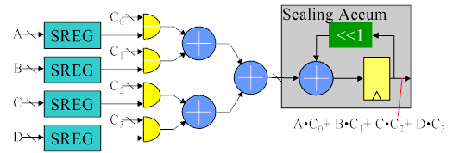
Distributed Arithmetic
K cycles
# Taps
Originally
Bit Level Rearrangement
N cycles
# bits

Slide 11

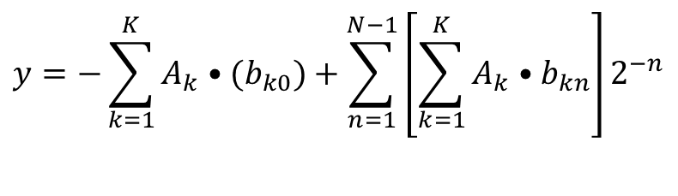
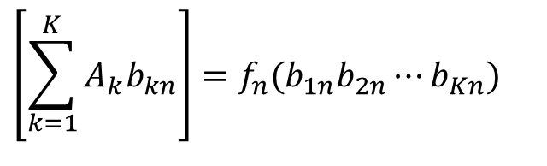
Distributed Arithmetic
has only 2^{K} possible values i.e.
These can be pre-calculated for all possible values of b_{1n} b_{2n …}b_{Kn}
Store these in a look-up table of 2^{K} words addressed by K-bits i.e. b_{1n} b_{2n …}b_{Kn}
$$y=−\sum_{k=1}^{K}{A_{k}•(b_{k0})}+\sum_{n=1}^{N−1}{\left[\sum_{k=1}^{K}{A_{k}•b_{kn}}\right]2^{−n}}$$
$$\left[\sum_{k=1}^{K}{A_{k}b_{kn}}\right]$$
$$\left[\sum_{k=1}^{K}{A_{k}b_{kn}}\right]=f_{n}(b_{1n}b_{2n}⋯b_{Kn})$$

Slide 12
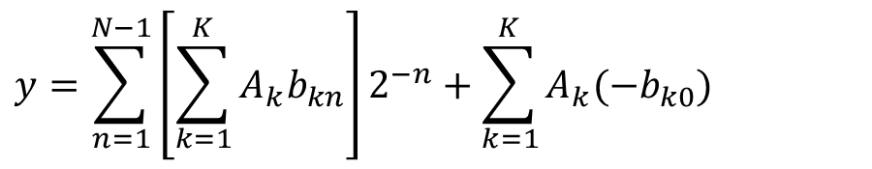
Distributed Arithmetic
Let number of taps K=4
The fixed coefficients are A₁ =0.72, A₂= -0.3, A₃ = 0.95, A₄ = 0.11
We need 2^{K} = 2⁴ = 16-words ROM
$$y=\sum_{n=1}^{N−1}{\left[\sum_{k=1}^{K}{A_{k}b_{kn}}\right]2^{−n}+\sum_{k=1}^{K}{A_{k}(−b_{k0})}}$$

Slide 13
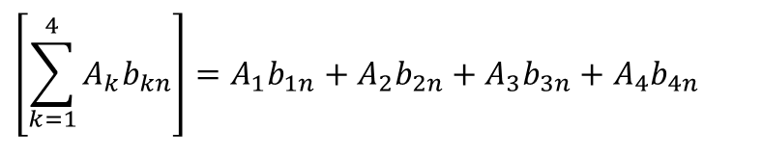
Distributed Arithmetic
b_{1n} | b_{2n} | b_{3n} | b_{4n} | Contents
0 | 0 | 0 | 0 | 0
0 | 0 | 0 | 1 | A₄=0.11
0 | 0 | 1 | 0 | A₃=0.95
0 | 0 | 1 | 1 | A₃+ A₄=1.06
0 | 1 | 0 | 0 | A₂=-0.30
0 | 1 | 0 | 1 | A₂+ A₄= -0.19
0 | 1 | 1 | 0 | A₂+ A₃=0.65
0 | 1 | 1 | 1 | A₂+ A₃ + A₄=0.75
1 | 0 | 0 | 0 | A₁=0.72
1 | 0 | 0 | 1 | A₁+ A₄=0.83
1 | 0 | 1 | 0 | A₁+ A₃=1.67
1 | 0 | 1 | 1 | A₁+ A₃ + A₄=1.78
1 | 1 | 0 | 0 | A₁+ A₂=0.42
1 | 1 | 0 | 1 | A₁+ A₂ + A₄=0.53
1 | 1 | 1 | 0 | A₁+ A₂ + A₃=1.37
1 | 1 | 1 | 1 | A₁+ A₂ + A₃ + A₄=1.48
$$\left[\sum_{k=1}^{4}{A_{k}b_{kn}}\right]=A_{1}b_{1n}+A_{2}b_{2n}+A_{3}b_{3n}+A_{4}b_{4n}$$
The fixed coefficients are A₁ =0.72, A₂= -0.3,
A₃ = 0.95, A₄ = 0.11

Slide 14
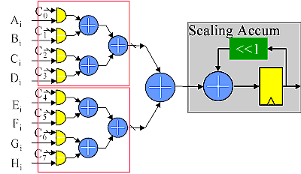
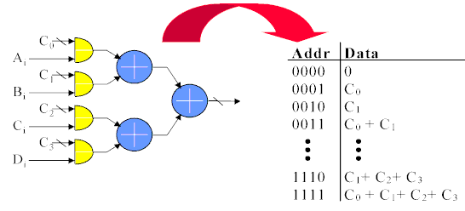
Decomposing the ROM
Requires additional adder to the sum the partial outputs

Slide 15
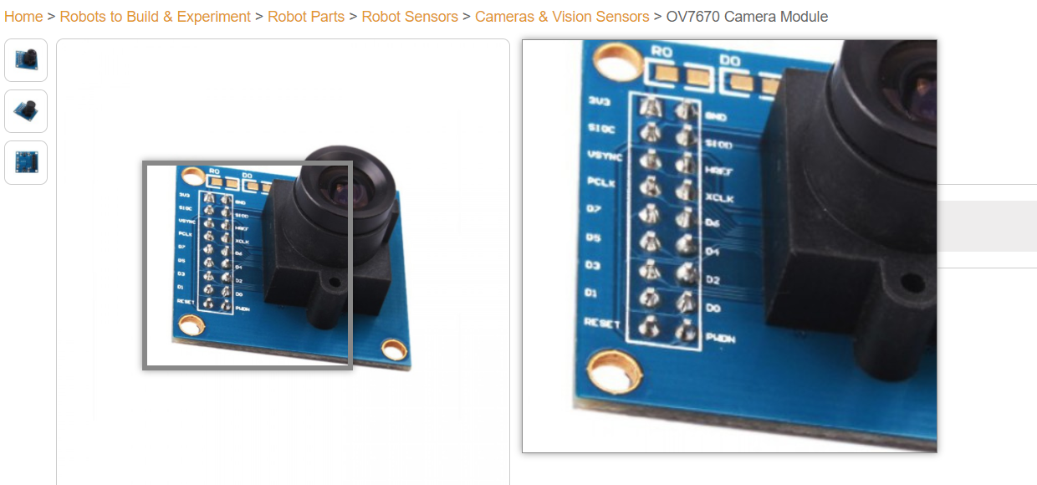
Digital Frame Grabber

Slide 16
Image Filter N x N
Digital Image Filter Implementation
Filter Rotated 180 Degrees

Slide 17
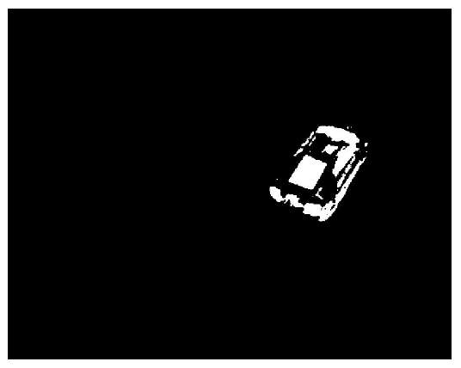
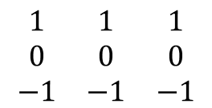
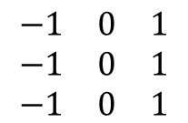
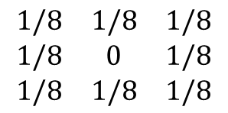
Image Filter N x N
Threshold +
$$\begin{matrix}1/8 & 1/8 & 1/8 \\ 1/8 & 0 & 1/8 \\ 1/8 & 1/8 & 1/8\end{matrix}$$
$$\begin{matrix}−1 & 0 & 1 \\ −1 & 0 & 1 \\ −1 & 0 & 1\end{matrix}$$
$$\begin{matrix}1 & 1 & 1 \\ 0 & 0 & 0 \\ −1 & −1 & −1\end{matrix}$$

Slide 18
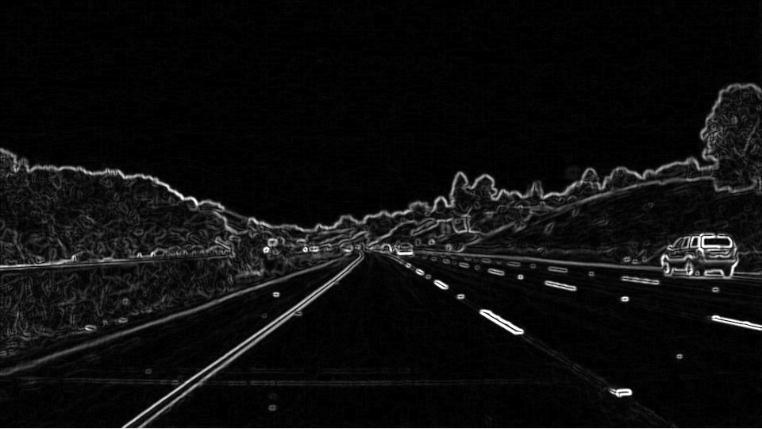
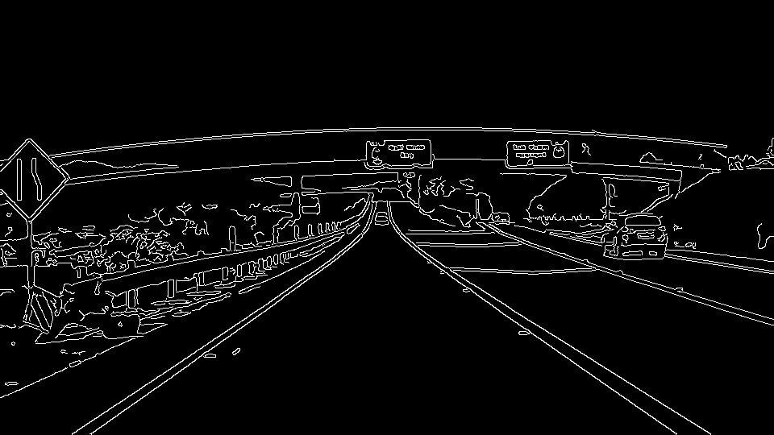
Image Filter N x N

Slide 19
Image Filter N x N

Slide 20
Distributed Arithmetic

Slide 21
MACs vs. Distributed Arithmetic
Filter (# taps) | Slices | LUTs | FFs
6 | 264 | 213 | 509
10 | 474 | 406 | 916
13 | 386 | 334 | 749
20 | 856 | 705 | 1650
28 | 1294 | 1145 | 2508
41 | 2154 | 1719 | 4161
61 | 3264 | 2591 | 6303
119 | 6009 | 4821 | 11551
151 | 7579 | 6098 | 14611
Filter (# taps) | Slices | LUTs | FFs
6 | 524 | 774 | 1012
10 | 781 | 1103 | 1480
13 | 929 | 1311 | 1775
20 | 1191 | 1631 | 2288
28 | 1774 | 2544 | 3381
41 | 2475 | 3642 | 4748
61 | 3528 | 5335 | 6812
119 | 6484 | 9754 | 12539
151 | 8274 | 12525 | 15988
Filter Implementation Using Add and Shift Method
Filter Implementation Using Non-DA (MACs)
Virtex II Pro

Slide 22
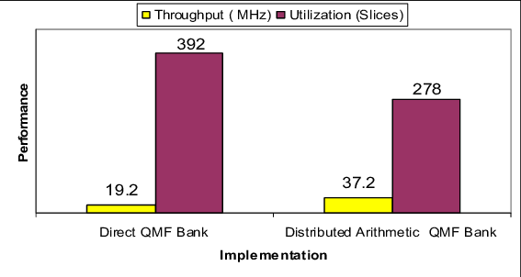
MACs – Distributed Arithmetic
Quadrature Mirror Filter, Al-Haj, et. al.

